Slide 1
Unit 9: Inheritance

AP CS A
Ms. Baniqued

Slide 2
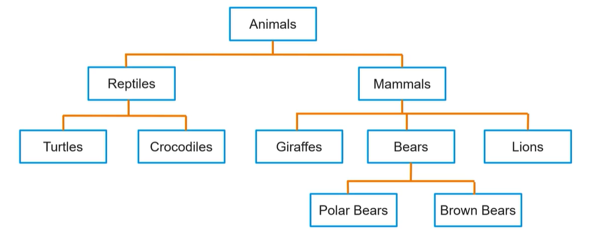
What is Inheritance?
When we think of inheritance, we think of a trait a child may receive from a parent, like eye color, athletic skills, or some other biological characteristic.
In Java, we use inheritance to build a hierarchy of classes that possess similar characteristics.
Parent classes (or superclasses) have attributes and behaviors that can be inherited by child classes (or subclasses).

Slide 3
Why use inheritance?
Code reusability – Higher level classes can be used over and over again in many situations
Prevents repeating code – Common methods and variables are now in one location, rather than many
Readability and organization – Having a solid, organized structure of your classes and objects allows for greater readability and cohesion
Ease of maintenance – Changing a general behavior in one place rather than many saves time and effort.

Slide 4
Writing Subclasses

AP CS A
Ms. Baniqued

Slide 5
Scenario: Performers, Musicians, Comedians, Dancers, Ballet Dancers
Consider a scenario where you are designing a simulation game.
Among the many types of characters in the game, there are performers. Performers have a name, age, a hometown, and an agent.
All performers can practice and perform. There are also many different types of performers, including musicians, comedians, dancers, and ballet dancers. Each type of performer will have the common performer characteristics, but they will also have specific attributes and behaviors that relate to their individual group.
Notes:
In Performer.java, what are the fields? What are the methods?

Slide 6
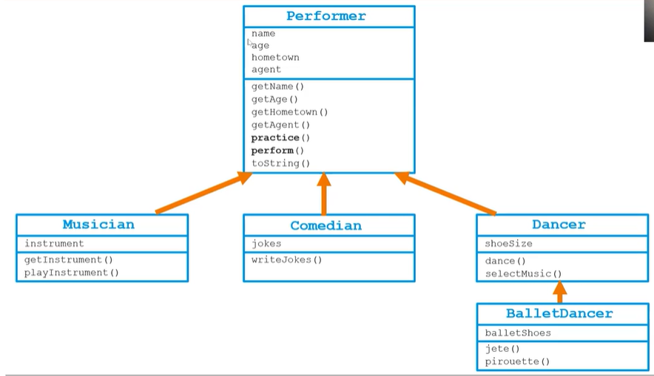
Notes:
In Performer.java, what are the fields? What are the methods?

Slide 7
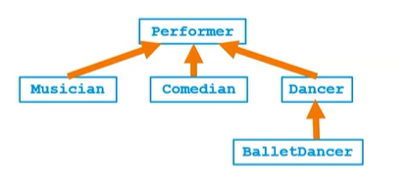
Superclasses and subclasses
Each subclass can only have one superclass. All subclasses inherit the attributes (fields) and methods of their superclasses.
Musician is a subclass of the superclass: _________________.
Comedian is a subclass of the superclass: _________________.
Dancer is a subclass of the superclass: _________________.
BalletDancer is a subclass of the superclass: _________________.
Whenever one class inherits another class, it is called an IS-A relationship.

Slide 8
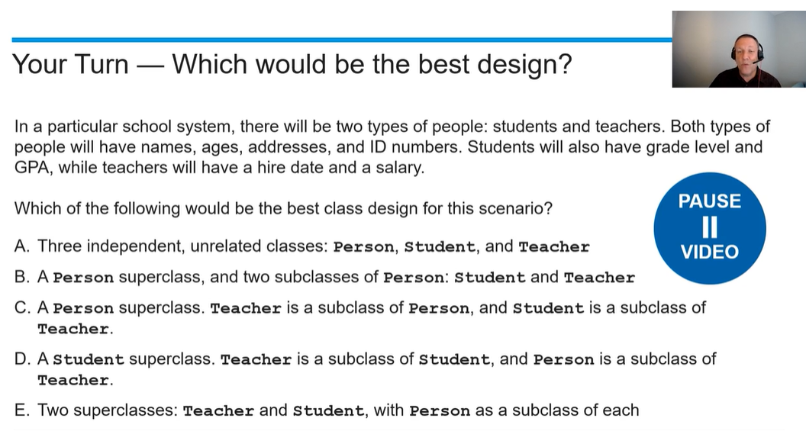

Slide 9
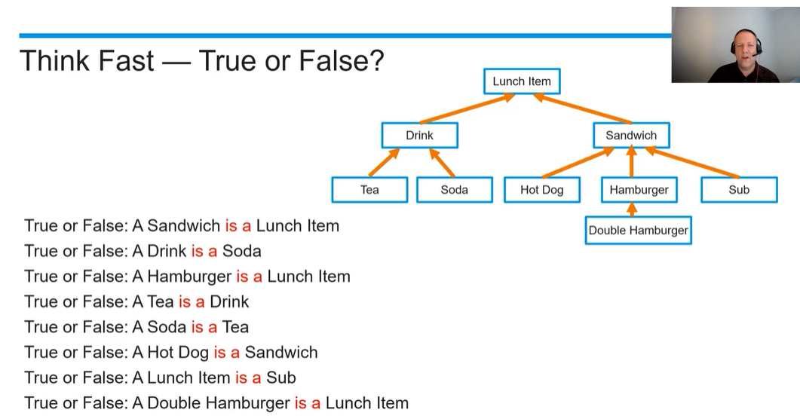

Slide 10
Unit 9 Vocabulary Review
Constructor
Superclass
Subclass
Alternate terminology for superclass/subclass
Attribute
Method signature
Instantiate
Inheritance
Overriding Methods
Object Class
Extends
IS-A Relationship
HAS-A Relationship

Slide 11
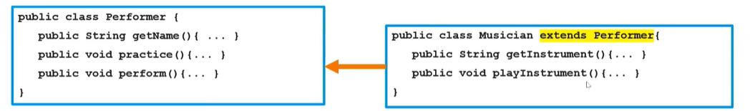

By using the extends keyword, the subclass Musician inherits all methods and fields of the superclass Performer without duplicating code.
Consider the following instances of Performer and Musician. Which method calls are valid or invalid?
Performer james = new Performer();
Musician lisa = new Musician();
lisa.getInstrument();
lisa.playInstrument();
lisa.getName();
lisa.practice();
lisa.perform();
james.getName();
james.practice();
james.perform();
james.getInstrument();
james.playInstrument();

Slide 12
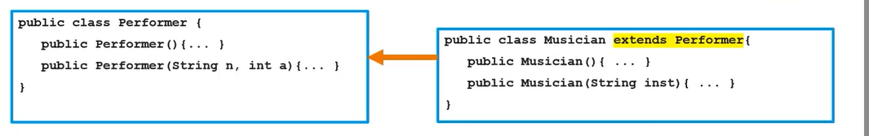

Constructors are not inherited.
Consider the following instances of Performer and Musician. Which Constructor calls are valid or invalid?
Performer james = new Performer();
Musician lisa = new Musician();
Performer james = new Performer(“James”, 19);
Musician lisa = new Musician(“Lisa”, 20);
Musician lisa = new Musician(“Saxophone”);
Performer james = new Performer(“Trumpet”);
Musician lisa = new Musician(“Lisa”, 20, “Saxophone”);
Notes:
Annotate what happens with the class as it is (implicit super() call)
What is the result of the Musician(String) constructor?
What if I want to define all the fields of a subclass in one line? (the last line on this slide). Create new constructors.

Slide 13
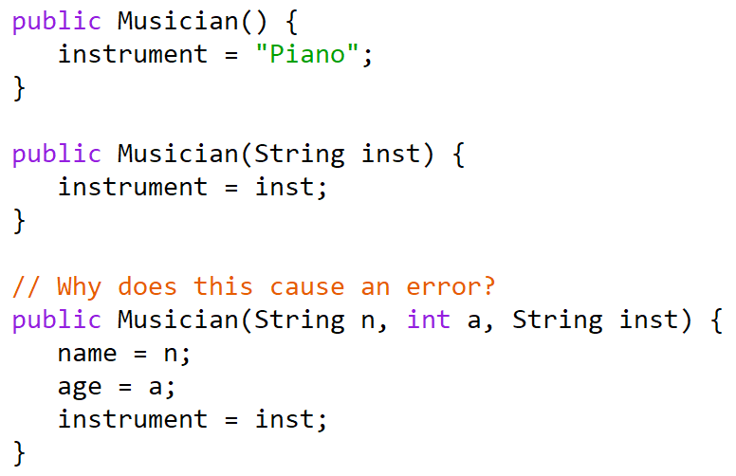
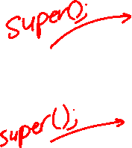
“But I thought subclasses inherit the fields of their superclass?”
Private fields are inherited, but not directly accessible.
Notes:
They are inherited, but not directly accessible.

Slide 14
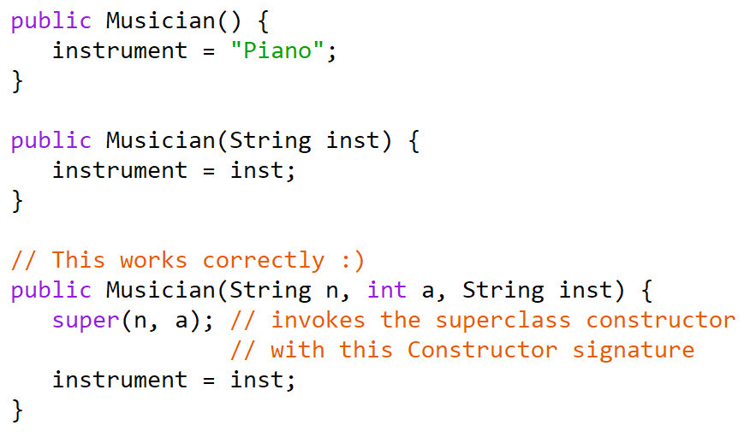
Notes:
Now let’s write Musician.java correctly AND write have you try Dancer.java on your own.

Slide 15
Notes:
Write Dancer.java and BalletDancer.java

Slide 16
Writing Subclasses
The following are true about writing subclasses:
When a subclass is created, it inherits its superclass’s public methods
The subclass can override its public inherited methods
A subclass does not have direct access to its superclass’s private fields. The superclass must provide public methods to allow its subclasses to access (getters) or modify (setters, other methods) its fields
A subclass can add new methods and fields to provide additional features specific to the subclass. A subclass should not create its own copies of the superclass’s fields. This is called shadowing and will cause issues.
A subclass should only create instance variables that store new attributes specific to that class

Slide 17
Overriding Methods and Calling Overridden Methods

AP CS A
Ms. Baniqued

Slide 18
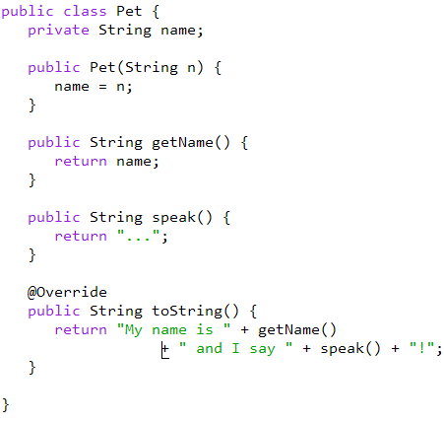
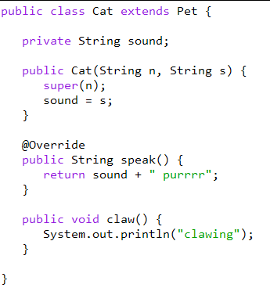
Overriding Methods
In Java, method overriding occurs when a subclass public method has the same signature as a method inherited from its superclass. A subclass can modify a method that is already defined in its superclass.
Overriding allows subclasses to adapt inherited behaviors to their specific needs.
Notes:
Git pull

Slide 19
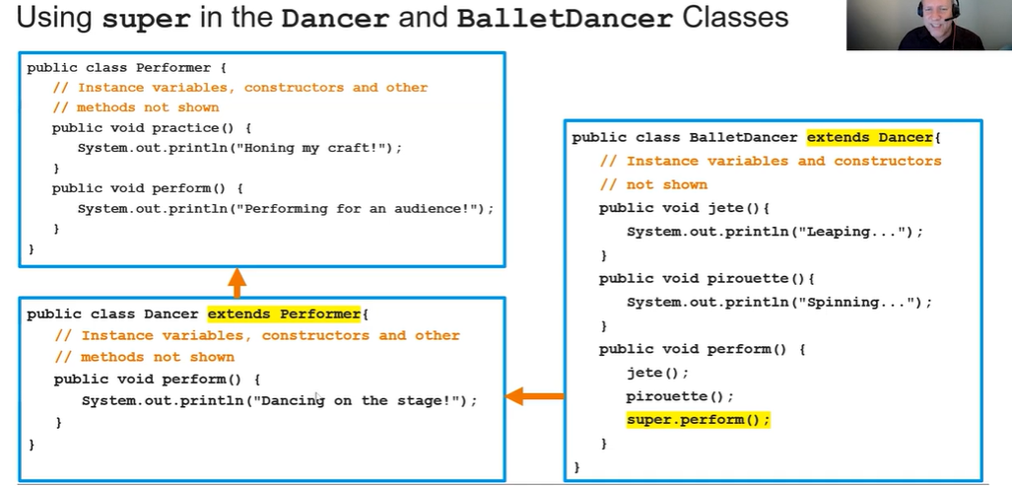
Calling Overridden Methods with the super keyword

Slide 20
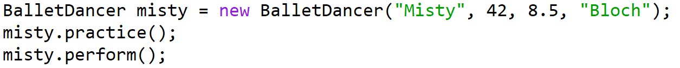
Consider the code below in a client class of Performer and its subclasses. What is the output?

Slide 21

P158 # 15-20 (13m exercise)
Jason | Matthew
Nate | Elisa
Henry | David
Greydon | Justin
Manuel | Juliana
Last 2 minutes for corrections

Slide 22
Polymorphism

AP CS A
Ms. Baniqued

Slide 23
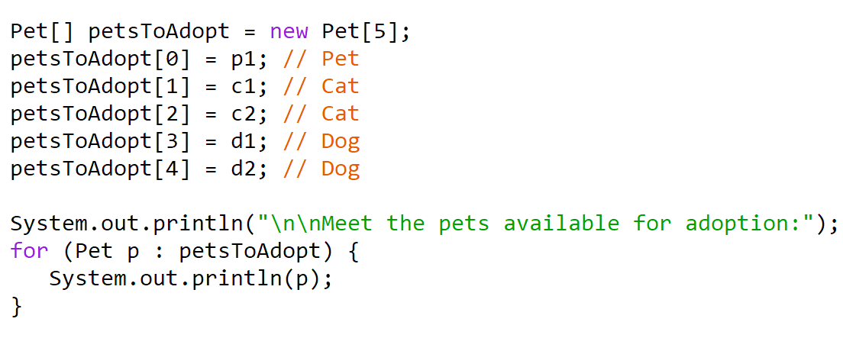
What is polymorphism?
A variable is polymorphic when it can refer to objects from different classes at different points in the code.
A reference variable can store a reference to its declared class or to any subclass of its declared class.
Notes:
See page 150 in your Barron’s for a good explanation

